Slide 1
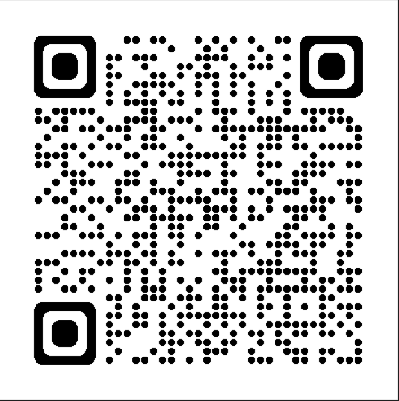

Predicting Covid19 Cases In Chest X-Ray Scans Using ML And DL. Lung Segmentation Using Advanced Image Processing
M.Sc. Thesis
Dr. Sári Zoltán
Joseph Twal

Slide 2
TABLE CONTENT
Previous Semester Work
Expected Goals Of Previous Semester Results
Methodology And Workflow
Methodology And Workflow (Lung Segmentation)
Results
Results – KNN
Results – SVC
Results – Lung Segmentation
Result - COVID-19 Application
References

Slide 3
Previous Semester Work
History Of Covid-19.
Previous Work studies.
Collecting Database X-Ray images.
Methodology and workflow.
Implement Machine learning models for classification
Support Vector Machine
K-Nearest Neighbor

Slide 4
Expected Goals Of Previous Semester Results
Use Deep learning models.
Make prediction not only classification.
Enhance Detection and Prediction.
Segmentation of lungs to make the detection more efficient if possible.(Future Studies)

Slide 5
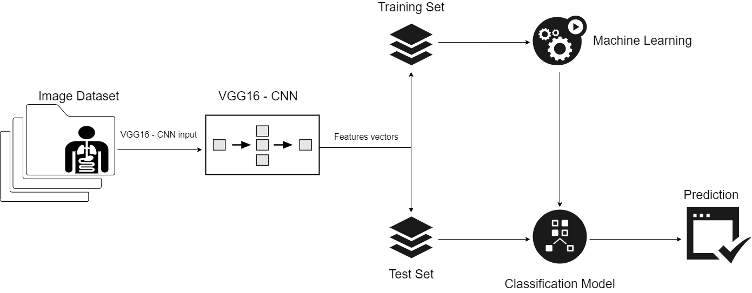
Methodology And Workflow

Slide 6
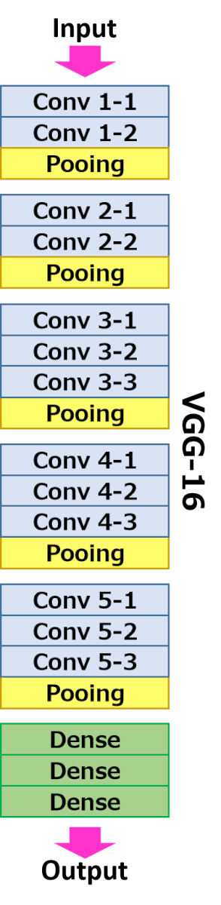
Methodology And Workflow
From the input layer to the last max pooling layer (labeled by 7 x 7 x 512) is regarded as feature extraction part of the model, while the rest of the network is regarded as classification part of the model.
FC (Fully Connected) layers are used to detect specific global configurations of the features detected by the lower layers in the net. Classification happens after feature extraction we need to classify the data into various classes, this can be done using a fully connected (FC) neural network
The use of max pool layer is similar to convolution layer, but instead of doing convolution operation, we are selecting the max values in the receptive fields of the input, saving the indices and then producing a summarized output volume.

Slide 7
Methodology And Workflow
For our KNN model, we used OneVsRestClassifier (One-vs-the-rest (OvR) multiclass strategy). Our model here is a multiclass classifier and we are obligated to use this in order to achieve the classification we need for KNN.
Also known as, one-vs-all, this strategy consists in fitting one classifier per class. For each classifier, the class is fitted against all the other classes. In addition to its computational efficiency, (only n_classes classifiers are needed); one advantage of this approach is its interpretability.
For SVM model, we used SVC (Support vector classifier) which is the multi-class classifier for more multiple clusters or subsets in the dataset; also, we consider using two kernels for the SVM (Linear and Radial Basis Function RBF). We wanted to study the difference and gather the best model with the highest accuracy and F1 score.
Gamma and C hyper parameters; C is a hypermeter which is set before the training model and used to control error and Gamma is also a hypermeter which is set before the training model and used to give curvature weight of the decision boundary.

Slide 8
Methodology And Workflow (Lung Segmentation)
Loading libraries and read the images from the directory
Convert the image to gray scale then increase the contrast of the image
Defining double threshold and covert the image into binary image.
Rremove the blobs connected to the boarder of the image
Labeling objects in the image
Keep the labels with two largest areas
Dilation operation
closing operation
Fill in the small holes inside the binary mask of lungs using roberts filter.
Superimpose the binary mask on the input image.

Slide 9
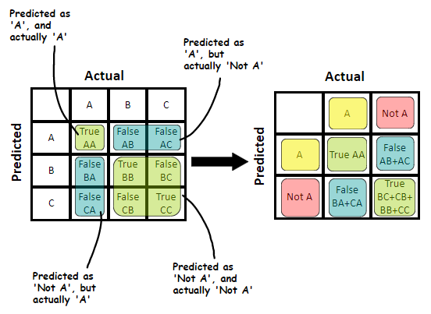
Results
For Multi-Classification, the approach to determine TP, TN, FP, and FN becomes different with small changes compared to the binary classification.

Slide 10
Results
 | KNN |  |  |  | SVM (Linear) |  |  |  | SVM (RBF)
 | Precision | Recall | F1 | Support | Precision | Recall | F1 | Support | Precision | Recall | F1 | Support
COVID | 0.93 | 0.96 | 0.94 | 1094 | 0.98 | 0.98 | 0.98 | 1094 | 0.98 | 0.98 | 0.98 | 1094
Normal | 0.94 | 0.9 | 0.92 | 933 | 0.97 | 0.97 | 0.97 | 933 | 0.97 | 0.97 | 0.97 | 933
Viral Pneumonia | 0.95 | 0.94 | 0.95 | 418 | 0.97 | 0.97 | 0.97 | 418 | 0.98 | 0.97 | 0.97 | 418
accuracy |  |  | 0.94 | 2445 |  |  | 0.97 | 2445 |  |  | 0.98 | 2445
macro avg | 0.94 | 0.94 | 0.94 | 2445 | 0.97 | 0.97 | 0.97 | 2445 | 0.98 | 0.98 | 0.98 | 2445
weighted avg | 0.94 | 0.94 | 0.94 | 2445 | 0.97 | 0.97 | 0.97 | 2445 | 0.98 | 0.98 | 0.98 | 2445
Notes:
The SE calculates the probability of a positive outcome of the disease. SP, on the other hand, calculates the probability of negative results in patients without the disease. The F1 score combines the values of precision and sensitivity; it balances the relative importance of each metric.

Slide 11
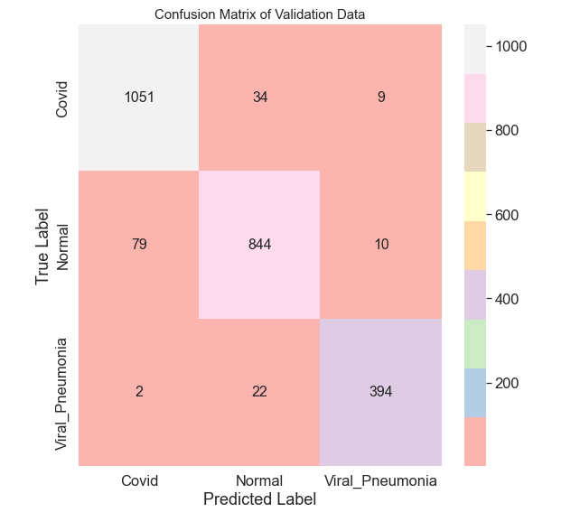
Results - KNN

Slide 12
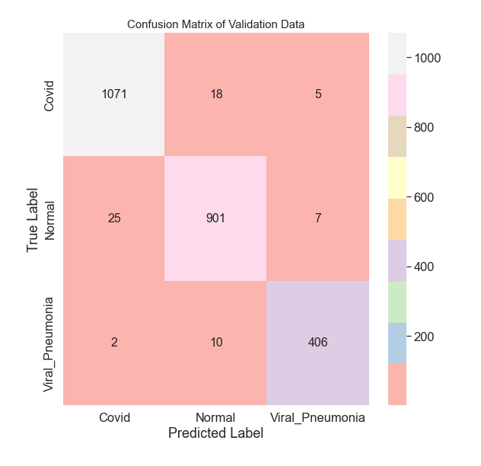
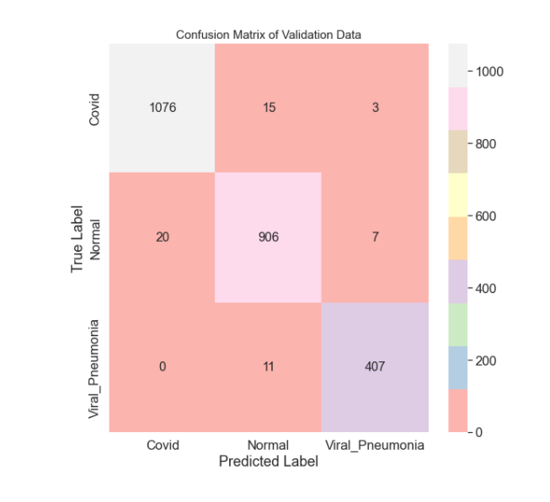
Results - SVC

Slide 13
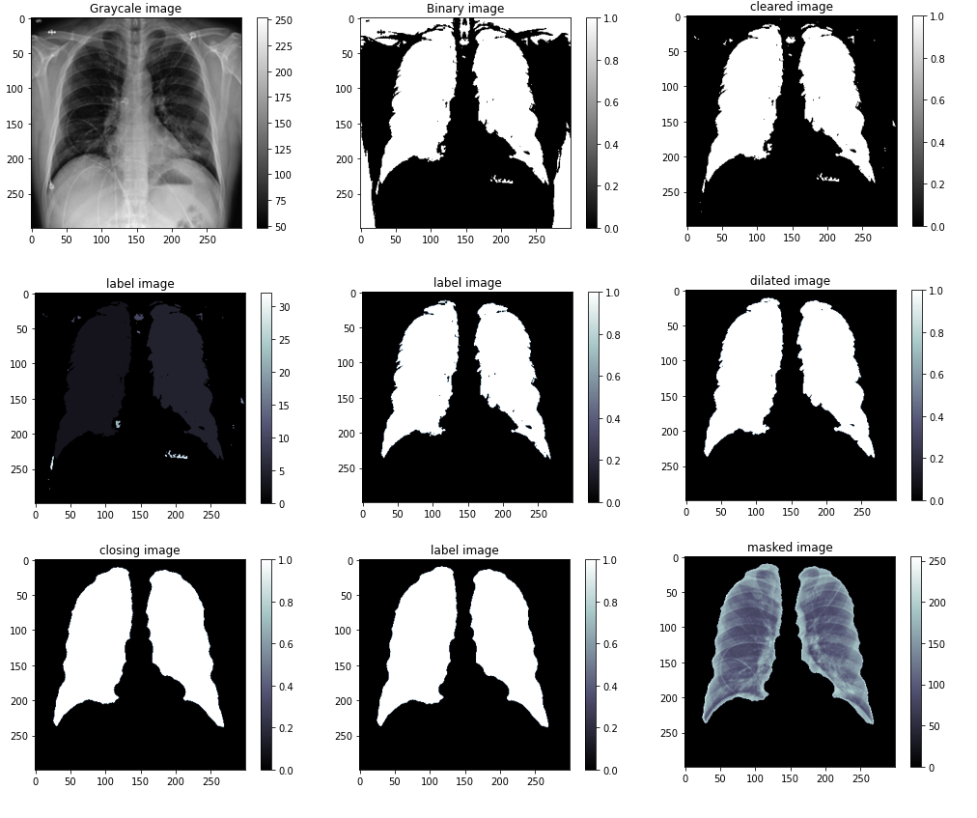
Results – Lung Segmentation

Slide 14
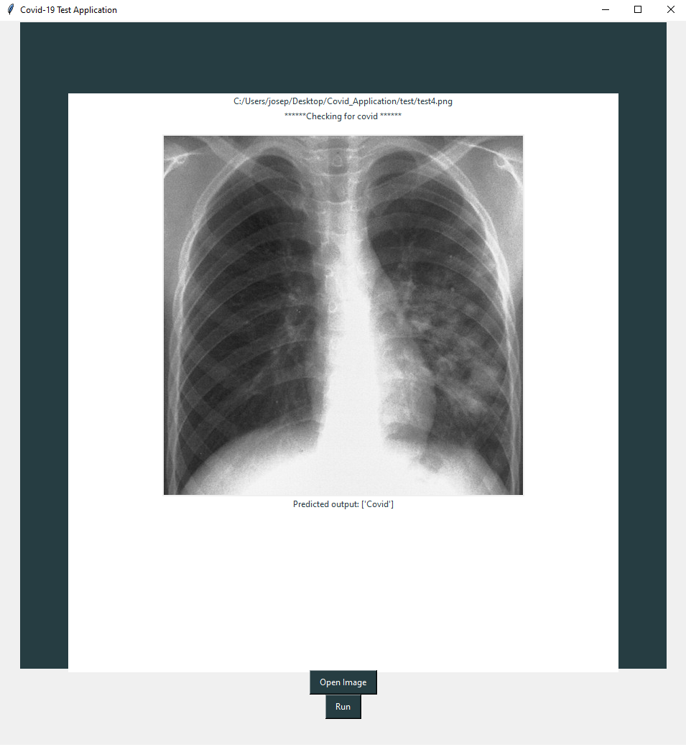
Result - COVID-19 Application

Slide 15
REFERENCES
World Health Organization, "Laboratory testing for coronavirus disease 2019 (COVID-19) in suspected human cases: interim guidance, 2 March 2020," World Health Organization, World Health Organization2020.
F. Jiang, L. Deng, L. Zhang, Y. Cai, C. W. Cheung, and Z. Xia, "Review of the clinical characteristics of coronavirus disease 2019 (COVID-19)," Journal of General Internal Medicine, pp. 1-5, 2020.
Z. Wu and J. M. McGoogan, "Characteristics of and important lessons from the coronavirus disease 2019 (COVID-19) outbreak in China: summary of a report of 72 314 cases from the Chinese Center for Disease Control and Prevention," Jama, 2020.
T. Ai, Z. Yang, H. Hou, C. Zhan, C. Chen, W. Lv, et al., "Correlation of chest CT and RT-PCR testing in coronavirus disease 2019 (COVID-19) in China: a report of 1014 cases," Radiology, p. 200642, 2020.
A. Narin, C. Kaya, and Z. Pamuk, "Automatic Detection of Coronavirus Disease (COVID-19) Using X-ray Images and Deep Convolutional Neural Networks," arXiv preprint arXiv:2003.10849, 2020.
H. S. Maghdid, A. T. Asaad, K. Z. Ghafoor, A. S. Sadiq, and M. K. Khan, "Diagnosing COVID-19 Pneumonia from X-Ray and CT Images using Deep Learning and Transfer Learning Algorithms," arXiv preprint arXiv:2004.00038, 2020.
S. U. K. Bukhari, S. S. K. Bukhari, A. Syed, and S. S. H. SHAH, "The diagnostic evaluation of Convolutional Neural Network (CNN) for the assessment of chest X-ray of patients infected with COVID-19," medRxiv, 2020.
H. Shi, X. Han, N. Jiang, Y. Cao, O. Alwalid, J. Gu, et al., "Radiological findings from 81 patients with COVID-19 pneumonia in Wuhan, China: a descriptive study," The Lancet Infectious Diseases, 2020.
COVID-19 Radiography Database | Kaggle

Slide 16
THANK YOU ☺
JOSEPH TWAL

